Slide 1
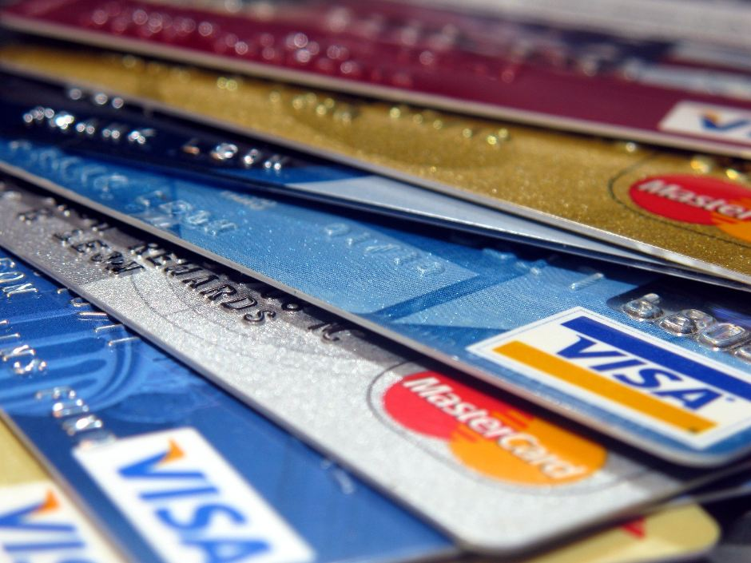
Complaints Crack the Code: Selecting the Best Credit Card for You
Team Synergy
Ishita Poorey
Vaishali Patidar
Anmol Fernandez
Ogechukwu Onyemaobim

Slide 2

Presentation Overview
An Introduction to Consumer Relationships with Credit Cards
Complaints and the Impact of Commonality
Exploring the Data: Dashboard analysis
Discovery Breakdown
Conclusion

Slide 3
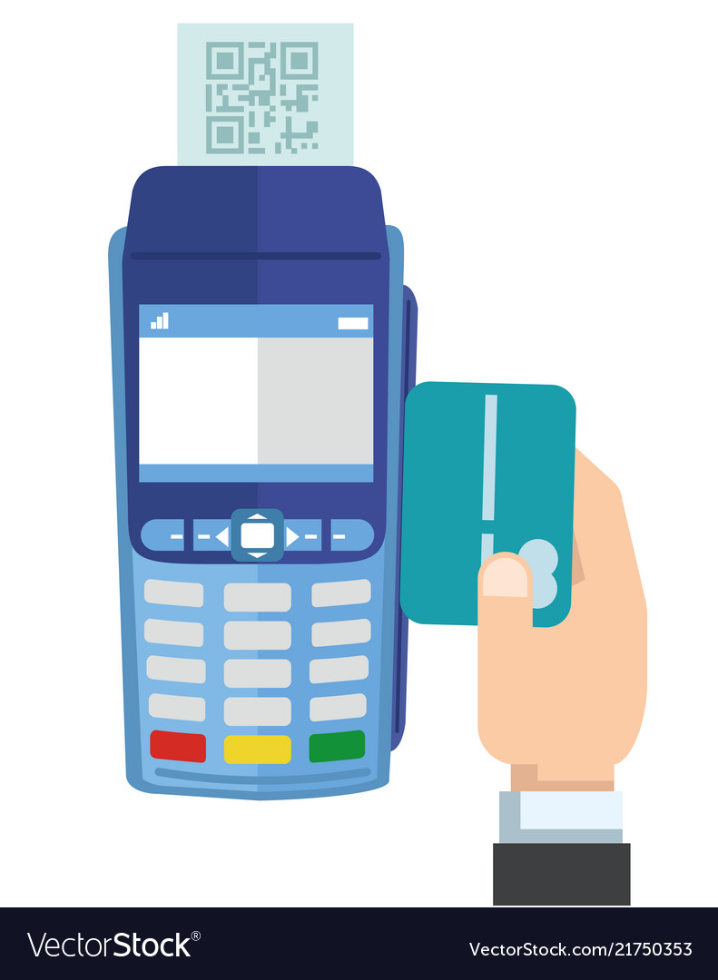
Credit Cards: Convenience at a Cost
Purchases can make consumers vulnerable to:
Unexpected Charges
Mystery Fees
Overdraft Penalties
Sky High Interest Rates
Identity Theft
How they respond to these issues is important but:
Who can they trust to resolve them?
Will complaints be taken seriously?
Are safeguards in place to protect them in the future?

Slide 4

Delving Into the Data: Do Consumers feel Supported?
Transitioning to the Data Dashboard:
Providing insight into consumer experiences when seeking resolution for their issues.
Highlighting common consumer complaints:
When
Where
Why
Consumer satisfaction ratings after reaching out to Customer Service.

Slide 5





Top 5 Providers: The Choice is Yours
We often focus on Credit Card Company offerings that appeal to a transactional relationship:
Low APR
Travel Points
Cash Back
Non-Monetary incentives should also impact which Credit Card Companies we choose to do business with:
High Quality Customer Service
Rate of Responsiveness
Company Accountability
Opportunity to review performance

Slide 6

What is more important to YOU?

Slide 7
Thank You!!

